Slide 1
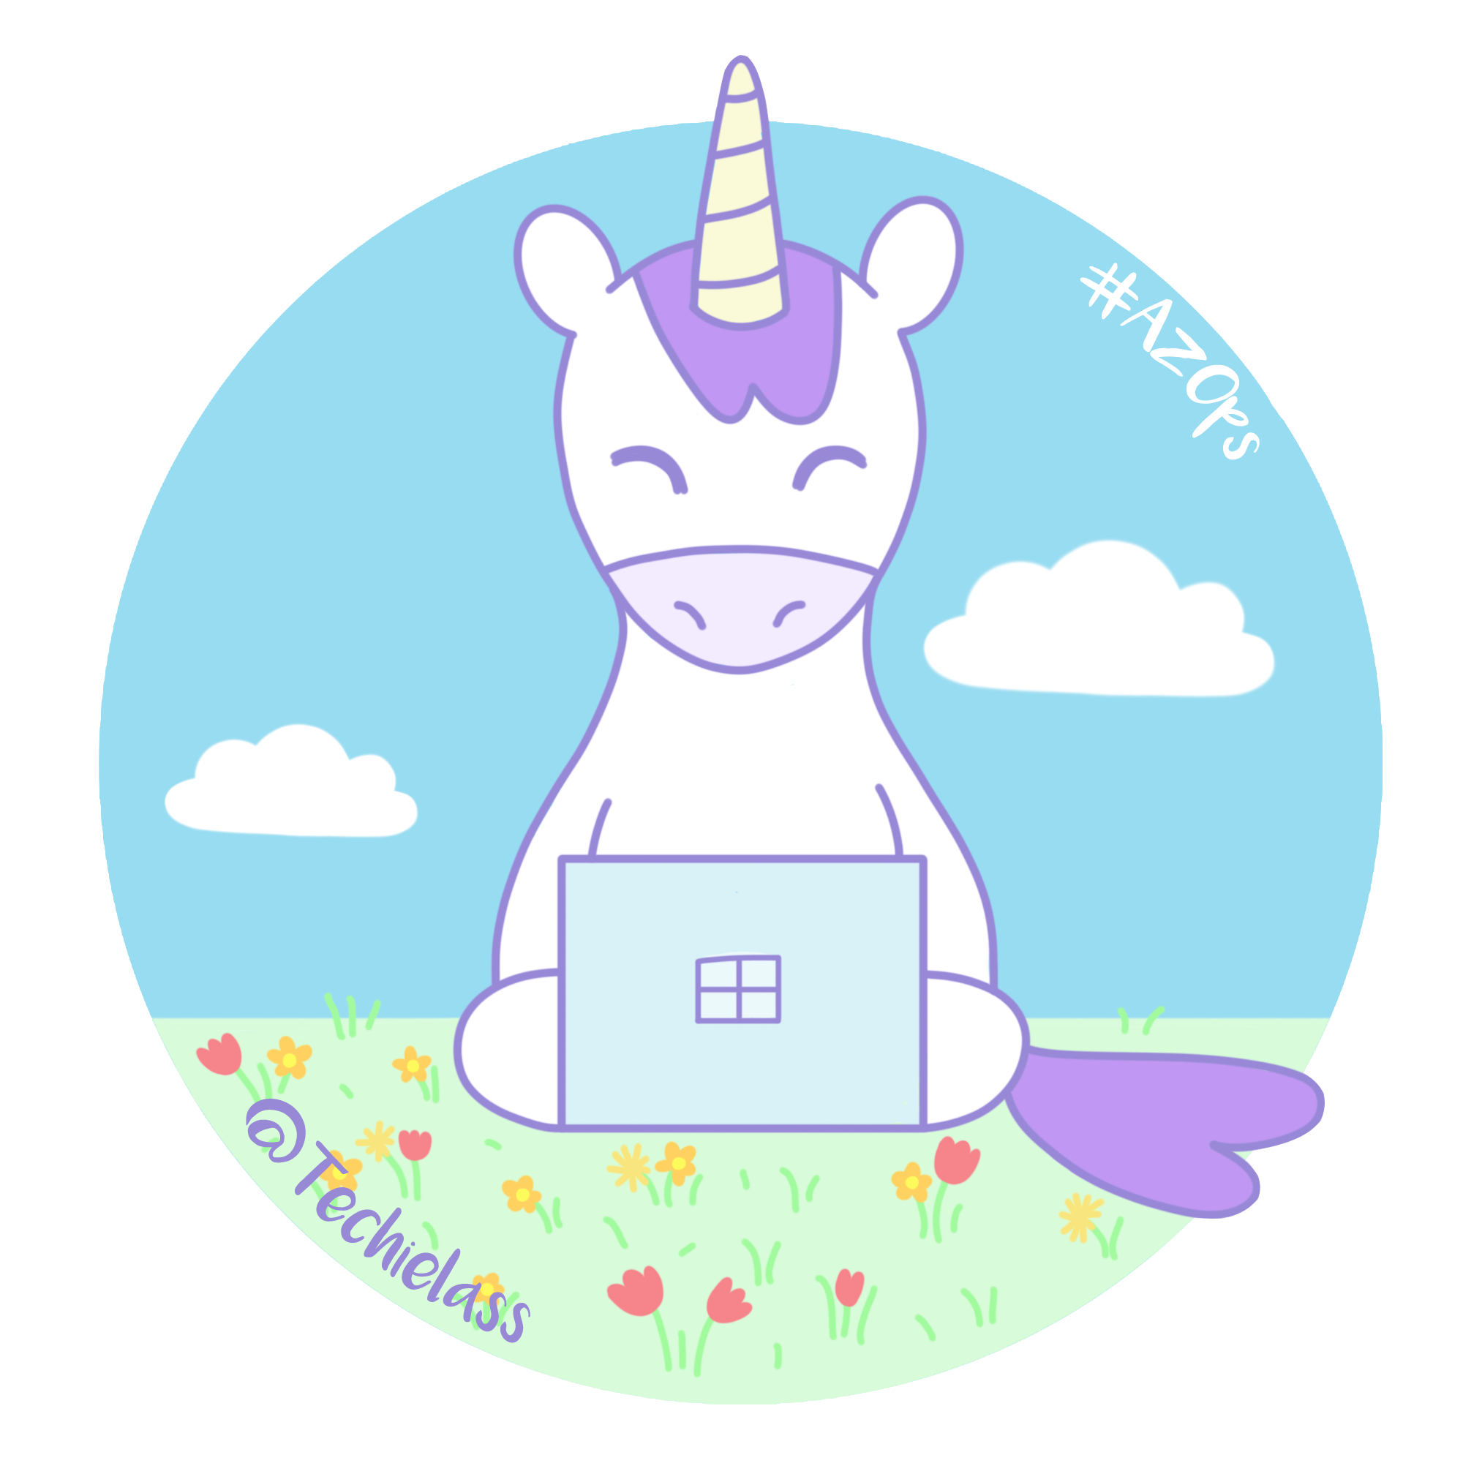
Striking the right balance while staying relevant
Sarah Lean
Cloud Advocate | Microsoft
@Techielass
Notes:
Test clicker

Slide 2
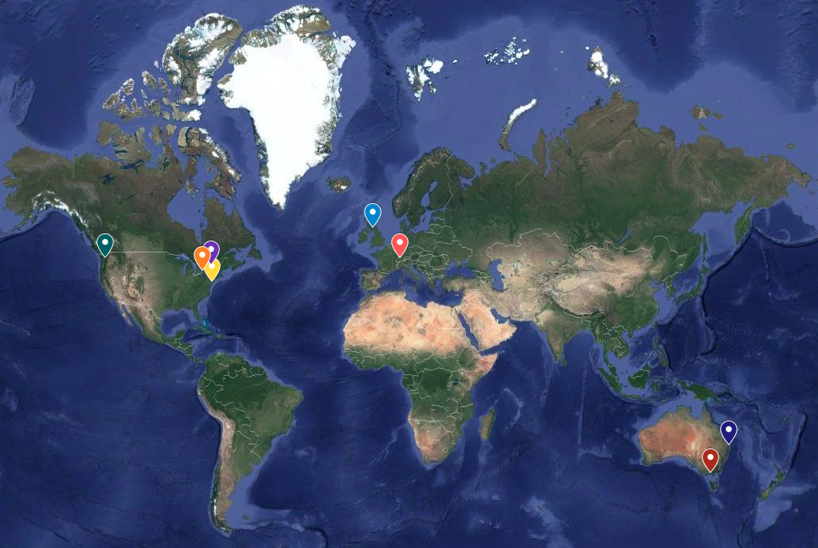
Notes:
I work in a global team

Slide 3
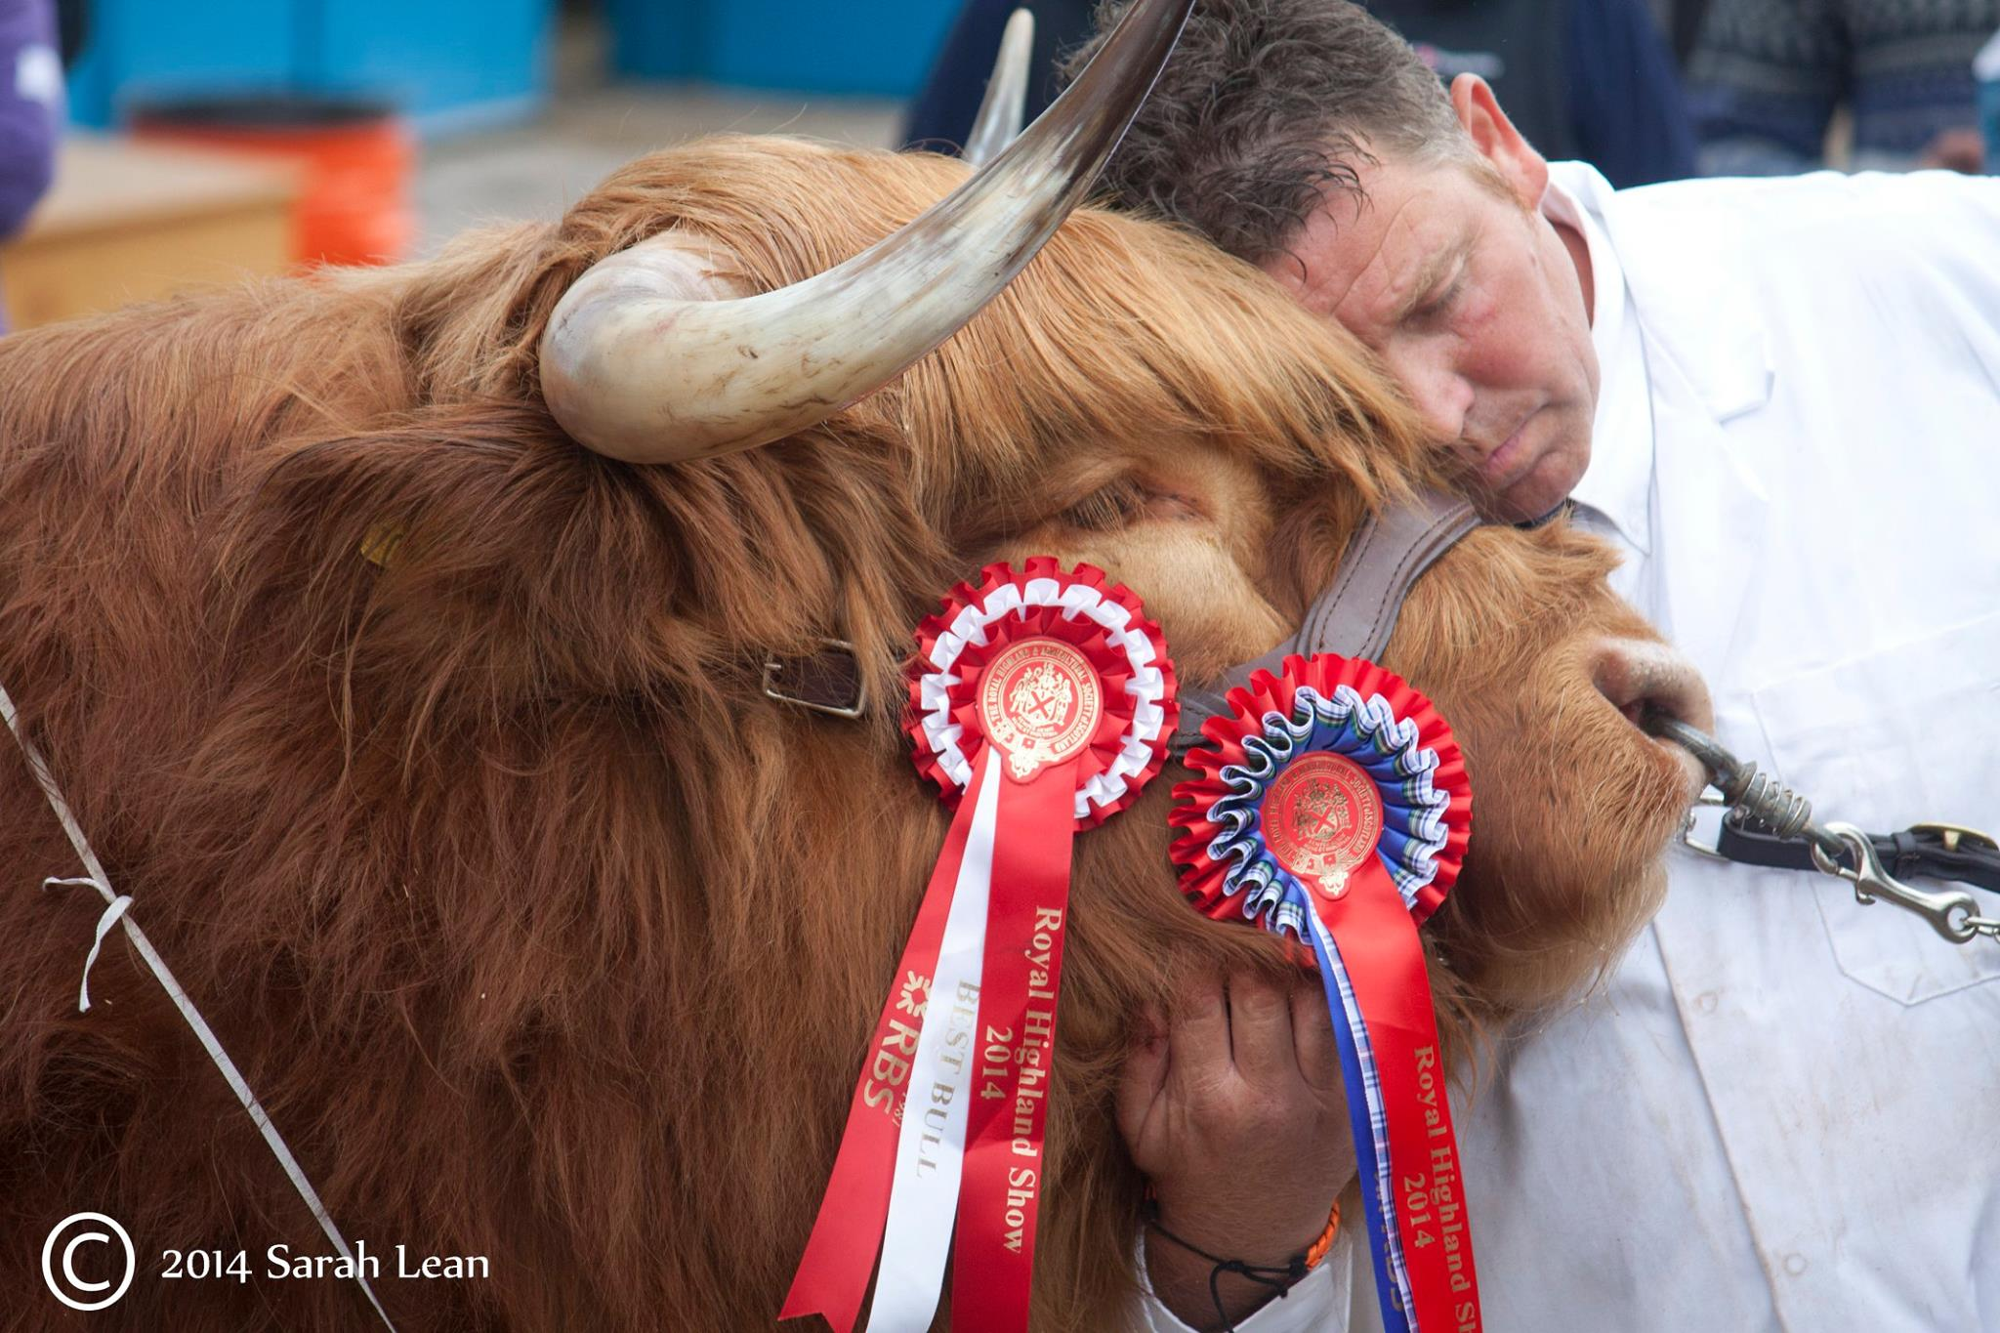
Scotland is the home of…
Notes:
I am from Scotland, and Scotland is the home of Highland Coos

Slide 4


Scotland is the home of…
Notes:
And Scotch Whisky, my favourite is the Balvenie

Slide 5
Scotland is the home of…
Keep the heid!
- Stay calm, don’t get upset
Haud yer wheesht!
- Be quiet
Am pure done in
- I’m tired
Bonnie
- Beautiful
Aye
- Yes
Naw
- No
Wee
- Small
Banter
- Joking around, having a laugh
Notes:
It’s also home of some crazy phrases and words

Slide 6

Sarah
Lean
@Techielass
Notes:
We all strive for balance, work life balance. Life can be crazy, it can be fun and it can be overwhelming at times if you let it.

Slide 7

Sarah
Lean
@Techielass
Notes:
We all carry devices around with us that mean we are never far from our loved ones, our friends, our work colleagues, news, movies, music, and lots more. We’re always connected. Always reachable.

Slide 8

Sarah
Lean
@Techielass
Notes:
Which is great in some respects, we don’t miss out on anything and up to date.

Slide 9

Sarah
Lean
@Techielass
Notes:
But it also leads to a lot of pressure and expectations and ultimately burn out. And we don’t want that. That’s not a good place to be in. Either from a personal or a professional point of view.

Slide 10

Sarah
Lean
@Techielass
Notes:
But if we disconnected and stop checking our phone, Twitter feed, emails, how will we ever say on top of it all. However will we be up to date with the latest feature released, with the latest update on that project at work.

Slide 11
How do I deal with this?
Notes:
Test clicker

Slide 12

Sarah
Lean
@Techielass
Notes:
Part of how I am trying to solve that is by having two phones. One for personal, one for work.

Slide 13
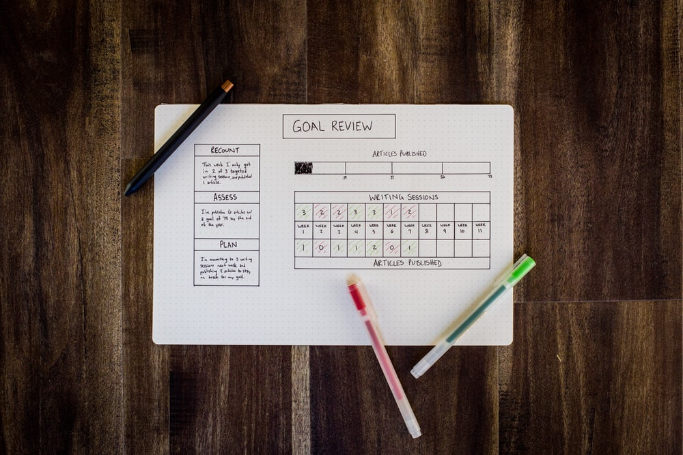
Sarah
Lean
@Techielass
Notes:
Set goals, set realistic goals but ones that stretch you.
Help you plan ahead and understand what you should be giving your time to and what you shouldn’t.

Slide 14
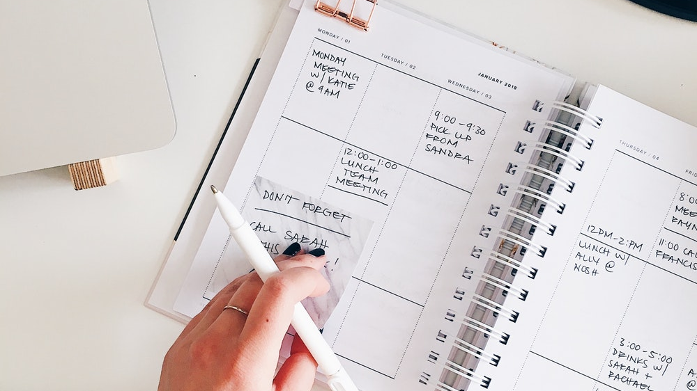
Sarah
Lean
@Techielass
Notes:
Schedule time. Book out weekends, book out time to LinkedIn, to Twitter etc
Book in lunch in the work diary, that’s part of my recharging process. Part of staying sane.

Slide 15
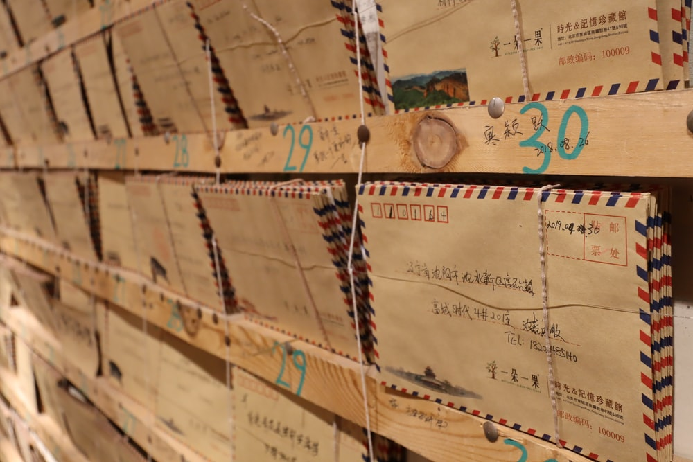
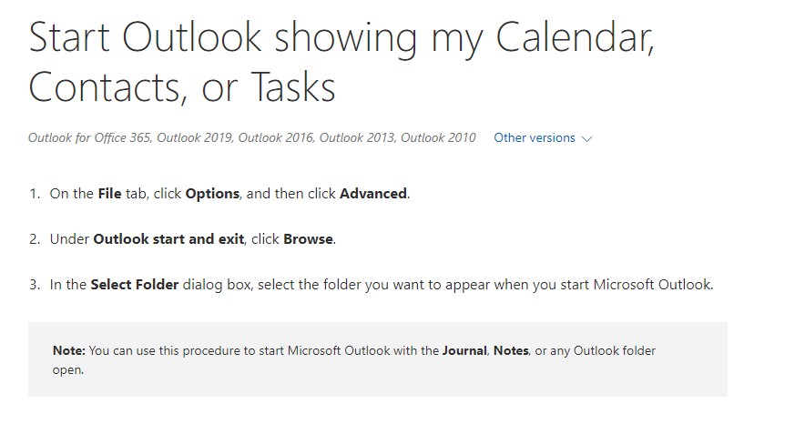
Sarah
Lean
@Techielass
Notes:
Opening outlook we often get caught up with the lastest items in our mailbox first thing and get lost. It’s happened to me, but something I’ve set up is opening outlook to my calendar, then I can see what is happening that day and take it from there.

Slide 16
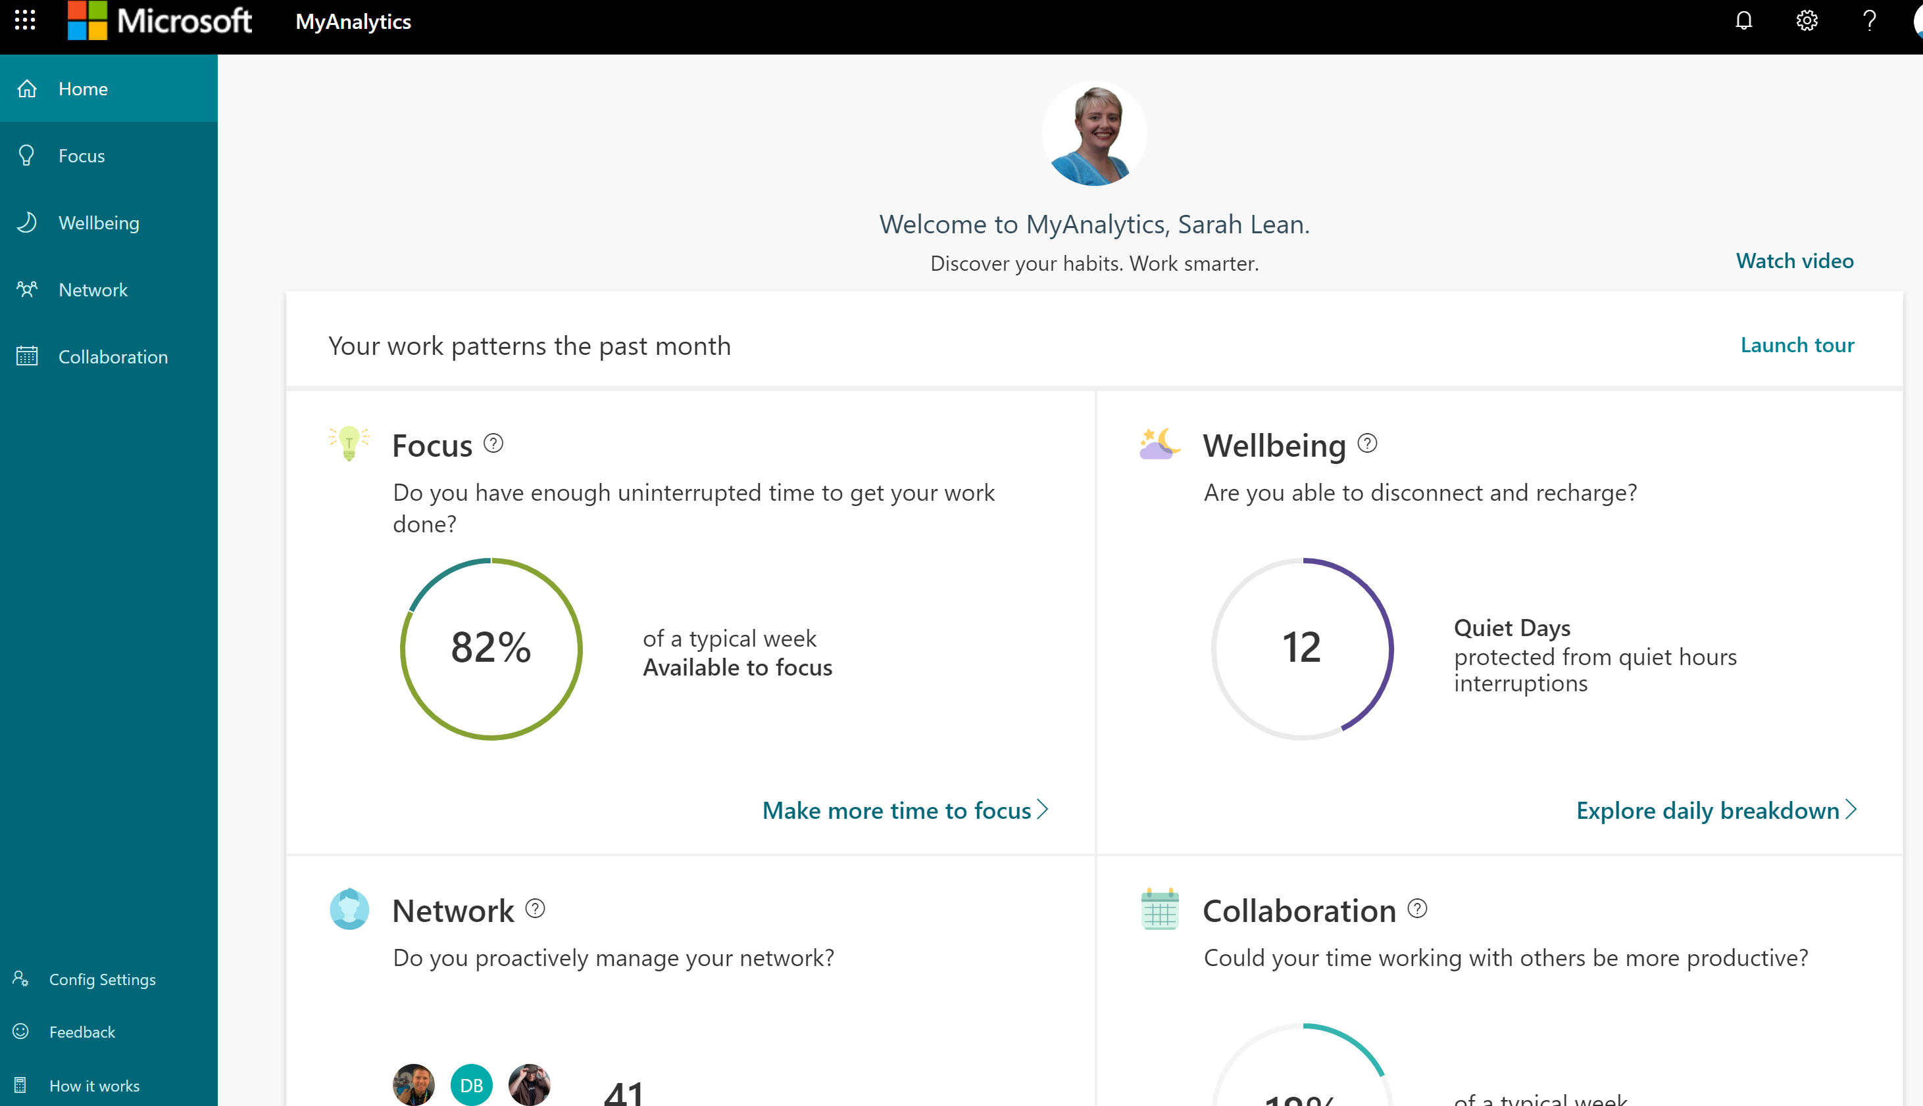
Sarah
Lean
@Techielass
Notes:
I use MyAnaltyics to makes sure I am not working to much out of hours

Slide 17
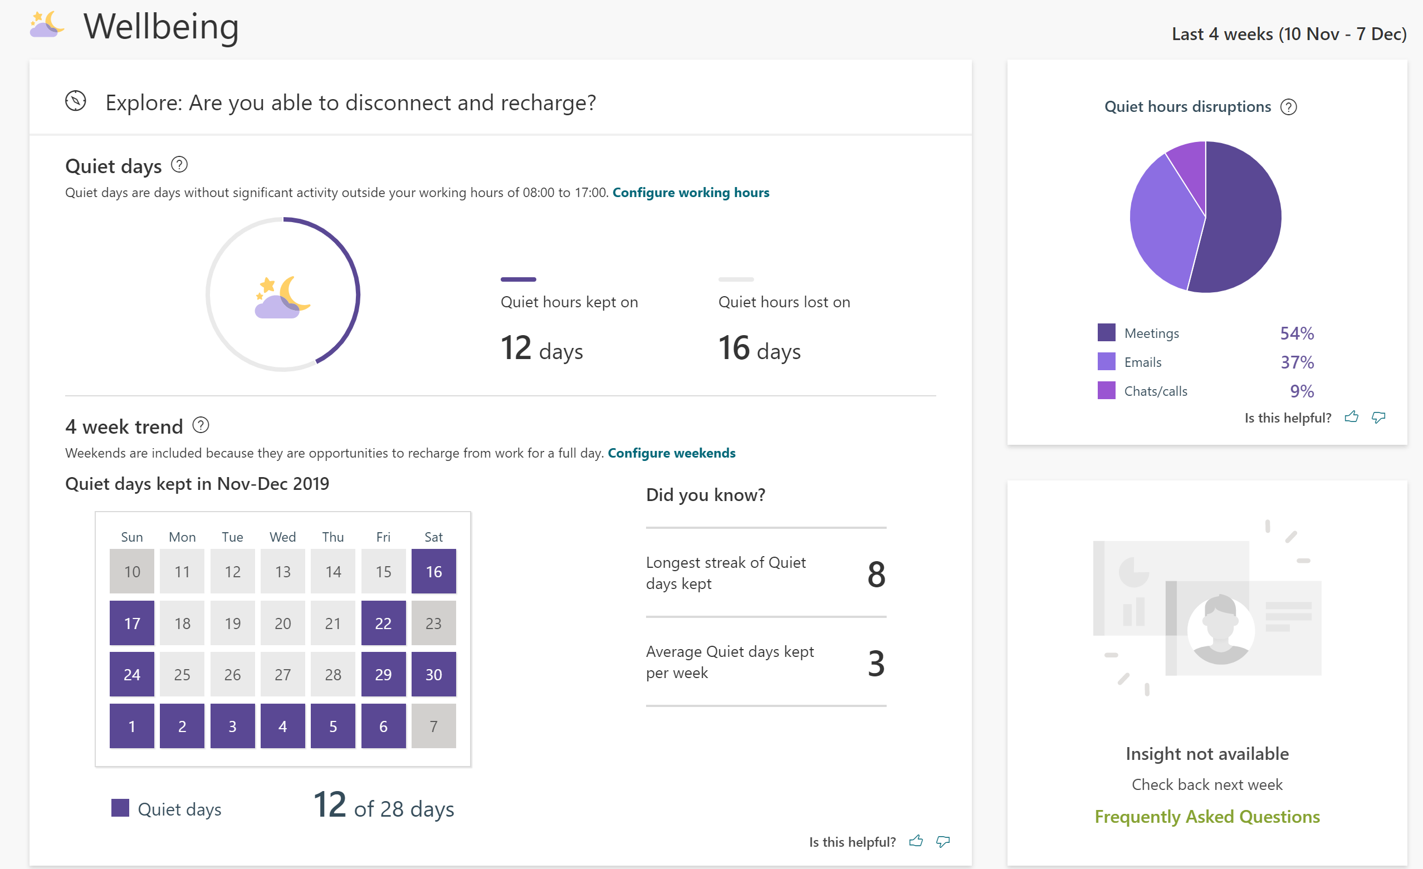
Sarah
Lean
@Techielass

Slide 18

Sarah
Lean
@Techielass
Notes:
Be mindful of your time, working hours. Get time back, be flexible.

Slide 19

Sarah
Lean
@Techielass
Notes:
Make time for your hobbies, find something that destresses you.

Slide 20

Sarah
Lean
@Techielass
Notes:
If you are investing your time in something you need to have some kind of measurement to see if it’s worth it right? I measure my Twitter stats, I monitor when things are most effective on LinkedIn, I view blog stats. I run a user group and I monitor the metrics there to see what works and what doesn’t, so I know where to spent my time and efforts in the future. Make sure you are spending your time wisely.

Slide 21
Social Media – how do I define it?
Notes:
Test clicker

Slide 22





Notes:
There are somethings that blur the line and make it hard to switch off.

Slide 23
Work & Personal
Notes:
There are somethings that blur the line and make it hard to switch off.

Slide 24
Personal
Notes:
There are somethings that blur the line and make it hard to switch off.

Slide 25
Work & Personal
Notes:
There are somethings that blur the line and make it hard to switch off.

Slide 26
Work
Notes:
There are somethings that blur the line and make it hard to switch off.

Slide 27
Work & Personal
Notes:
There are somethings that blur the line and make it hard to switch off.

Slide 28
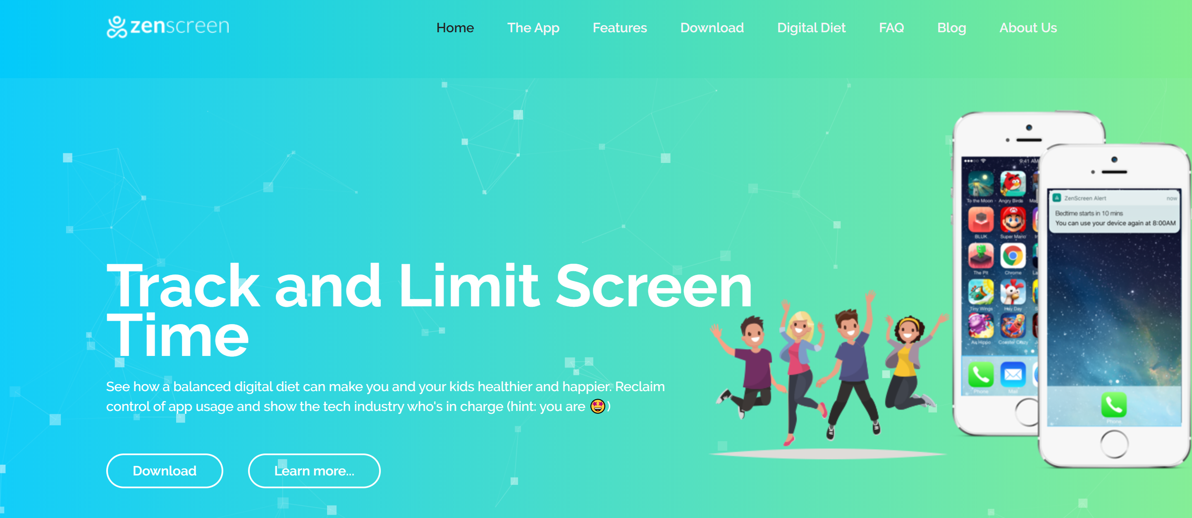
Notes:
I also use an app called ZenScreen to help limit my screen time on my phone.

Slide 29

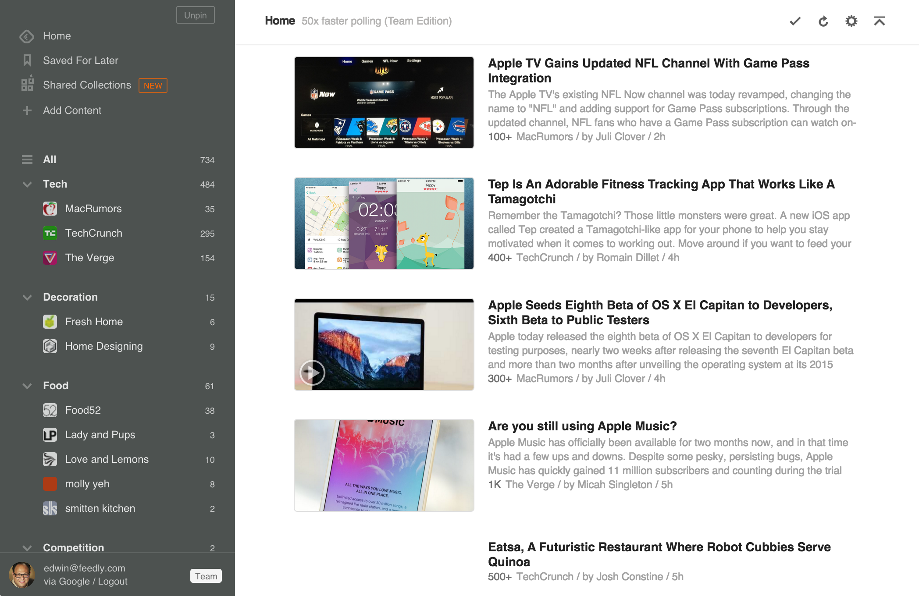
Notes:
Helps me collate the blogs I like to read in one place

Slide 30
It’s Okay to Say No
Notes:
It’s okay to say no. Saying yes to every request isn’t necessarily the best way forward. I’m a nightmare at always saying yes. When I really should say no.

Slide 31
Staying Up to Date
Notes:
Test clicker

Slide 32

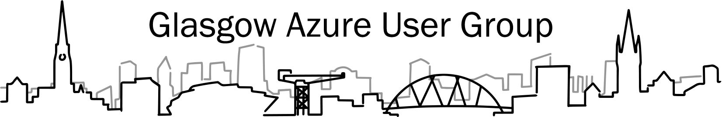



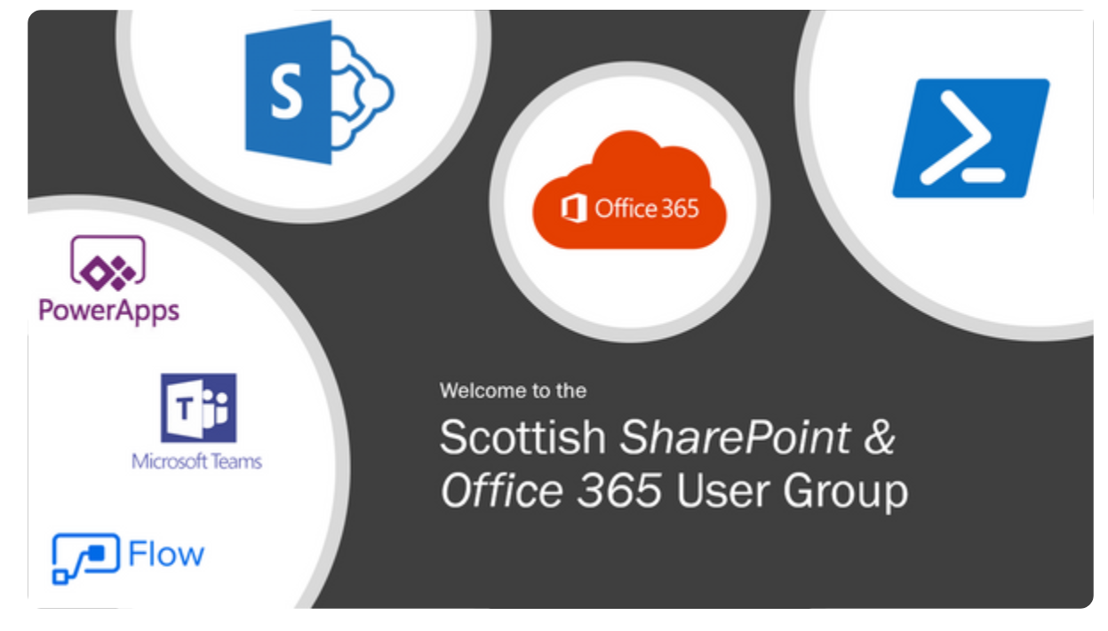
Notes:
User Groups, conferences. I invest in them, I go to them, I publicise them, I check what talks are being made to see trends.

Slide 33
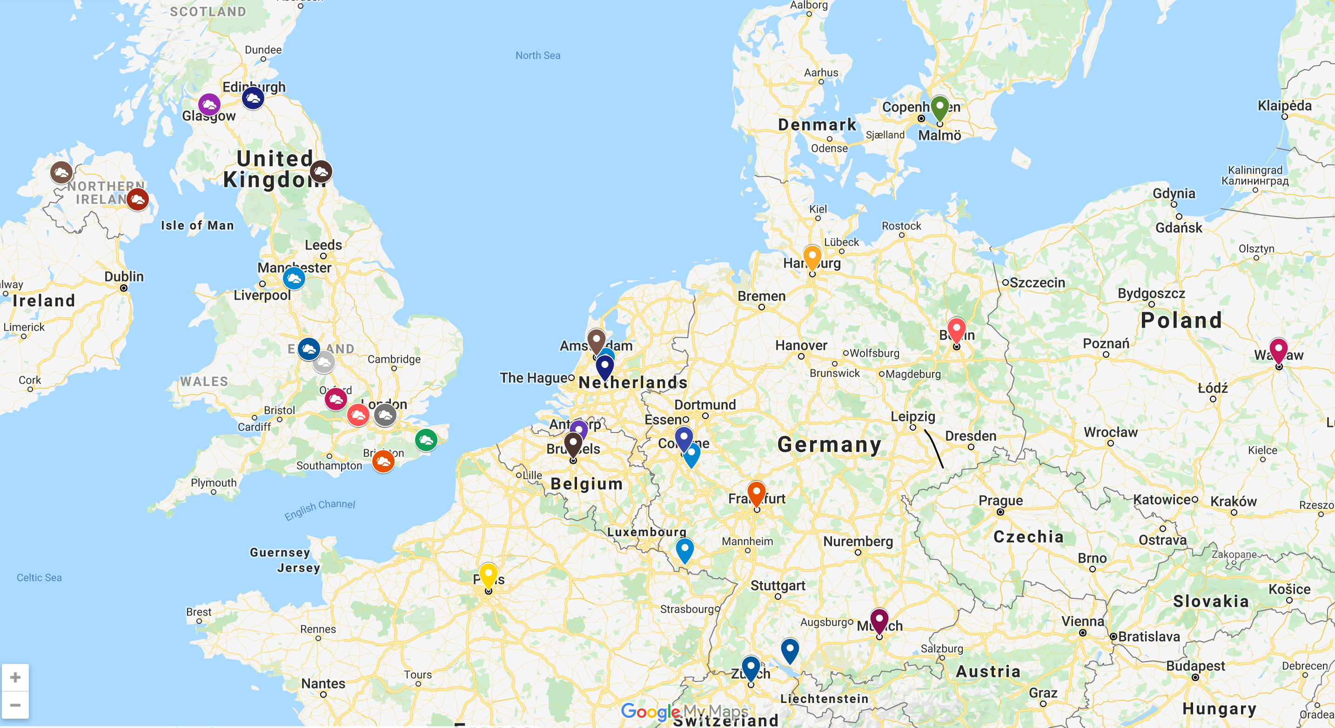
https://aka.ms/azurefamily

Slide 34

#azurefamily
#sqlfamily
#mvpbuzz
#azops
#itops
Notes:
I follow hashtags on Twitter to try and help keep up to date

Slide 35



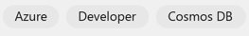
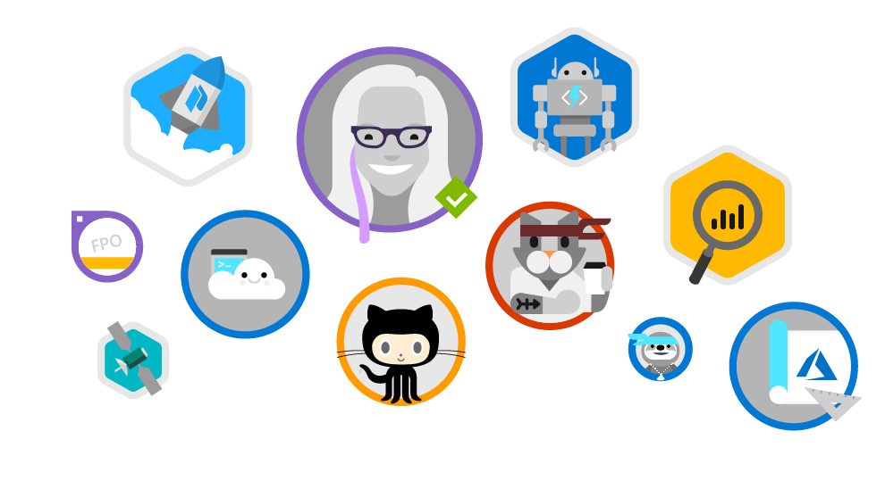
Microsoft Learn
www.microsoft.com/learn
Step-by-Step Learning
Gamification & Achievements
Friction-Free Learning
Guided microlearning by product/service, difficulty, job role, etc
Videos, tutorials, and hands-on learning
Role-based learning paths to prepare for certification
Unlock achievements
Task-based achievements to reward your hands-on skills
Customizable user profile
All learning content is free
Content available in the spoken language and programming language of my choice
No-install, browser-based Interactive coding/scripting environments
All scripts and code samples available for download
Sarah
Lean
@Techielass
Notes:
I spend a lot of time learning, or refreshing my skills, and I use Microsoft Learn for a large chunk of it. It’s free and easy to access.

Slide 36
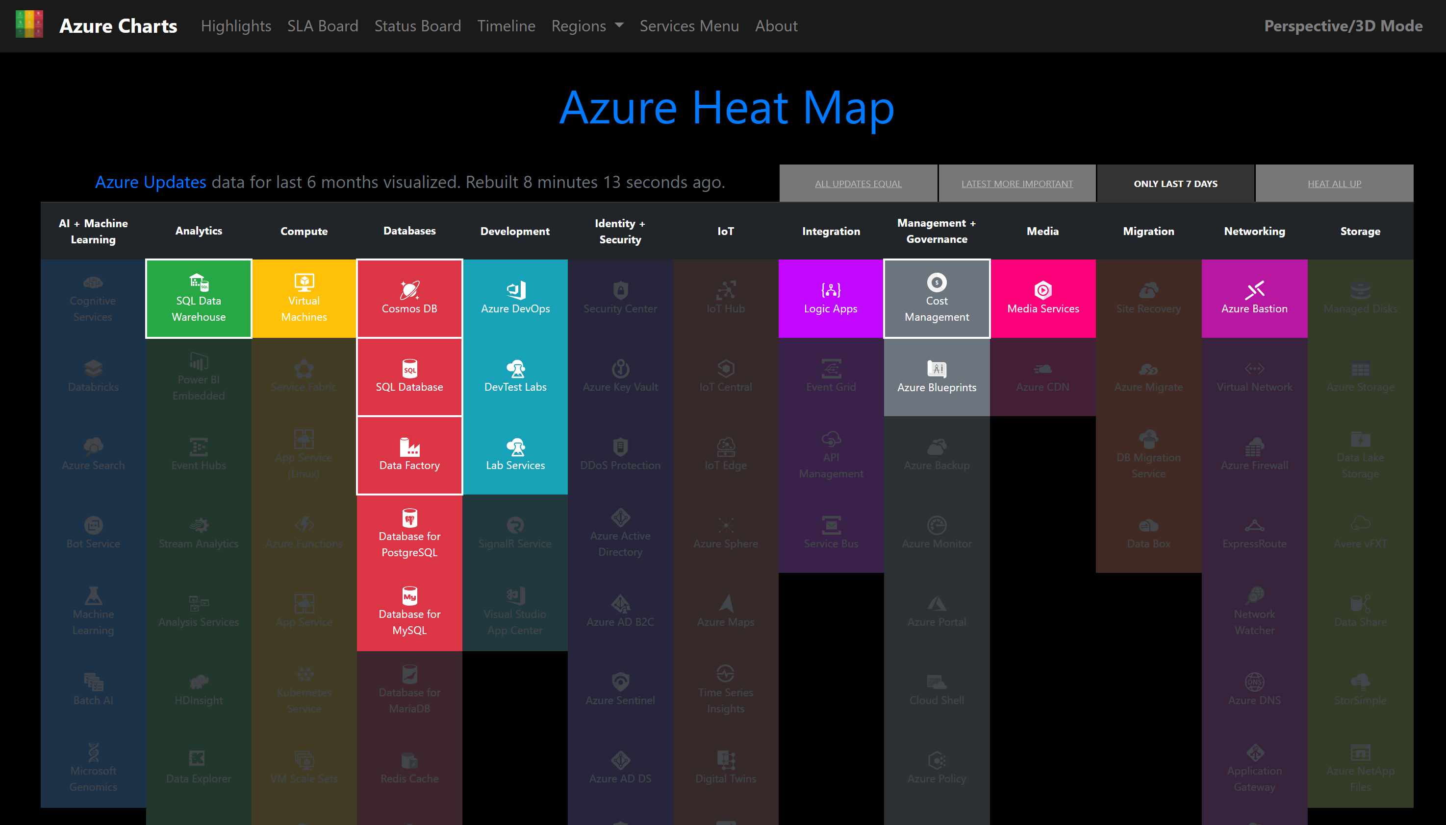
Sarah
Lean
https://azurecharts.com
@Techielass
Notes:
The Azure Heat Map is a great resource for quickly checking up on Azure updates

Slide 37
Conclusion
Notes:
Test clicker

Slide 38
No right or wrong answer.
Balance is what makes you happy. Makes you successful.

Slide 39
I’m not perfect.

Slide 40
Adapt.

Slide 41
Be Happy.

Slide 42
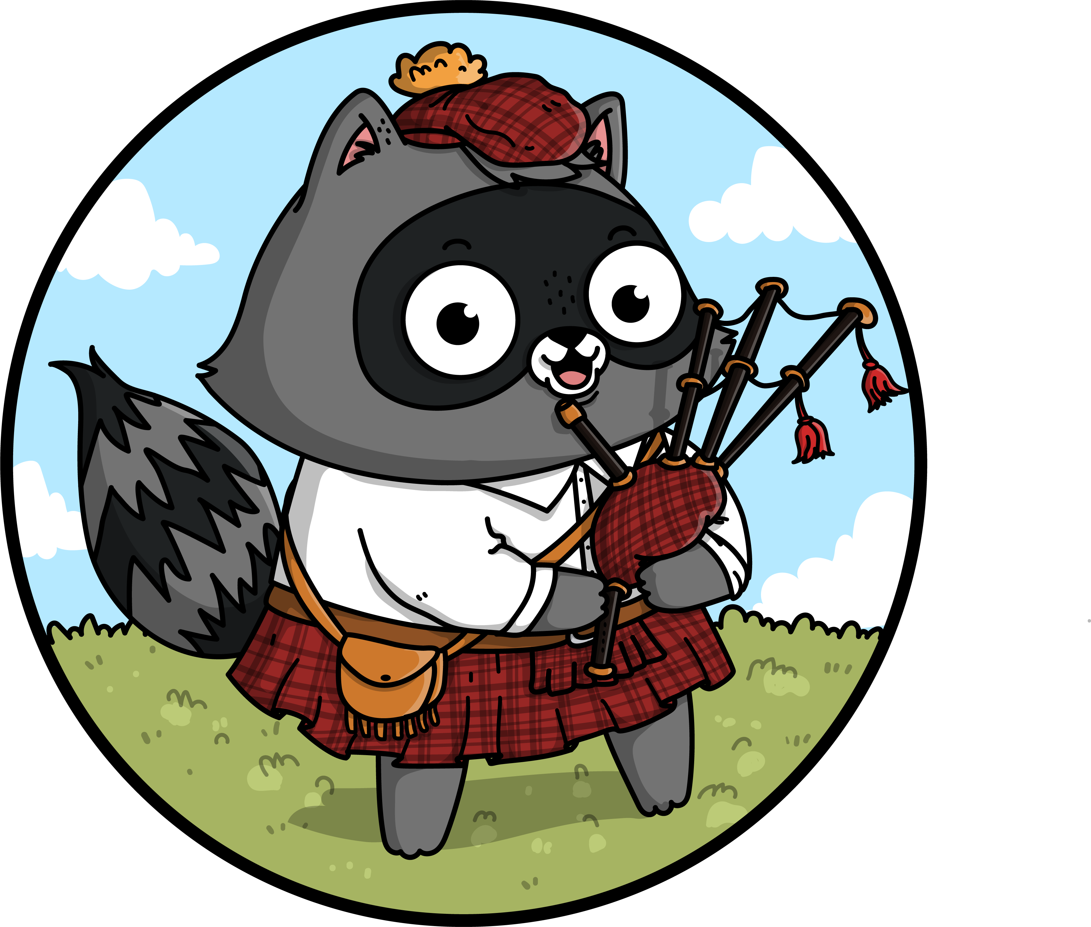
What are your tips?
Sarah Lean
Cloud Advocate
@Techielass | www.techielass.com

